Slide 1
Project 2: Storyboard
When Turtle Met Bear
Allison Williams
September 17, 2016

Slide 2
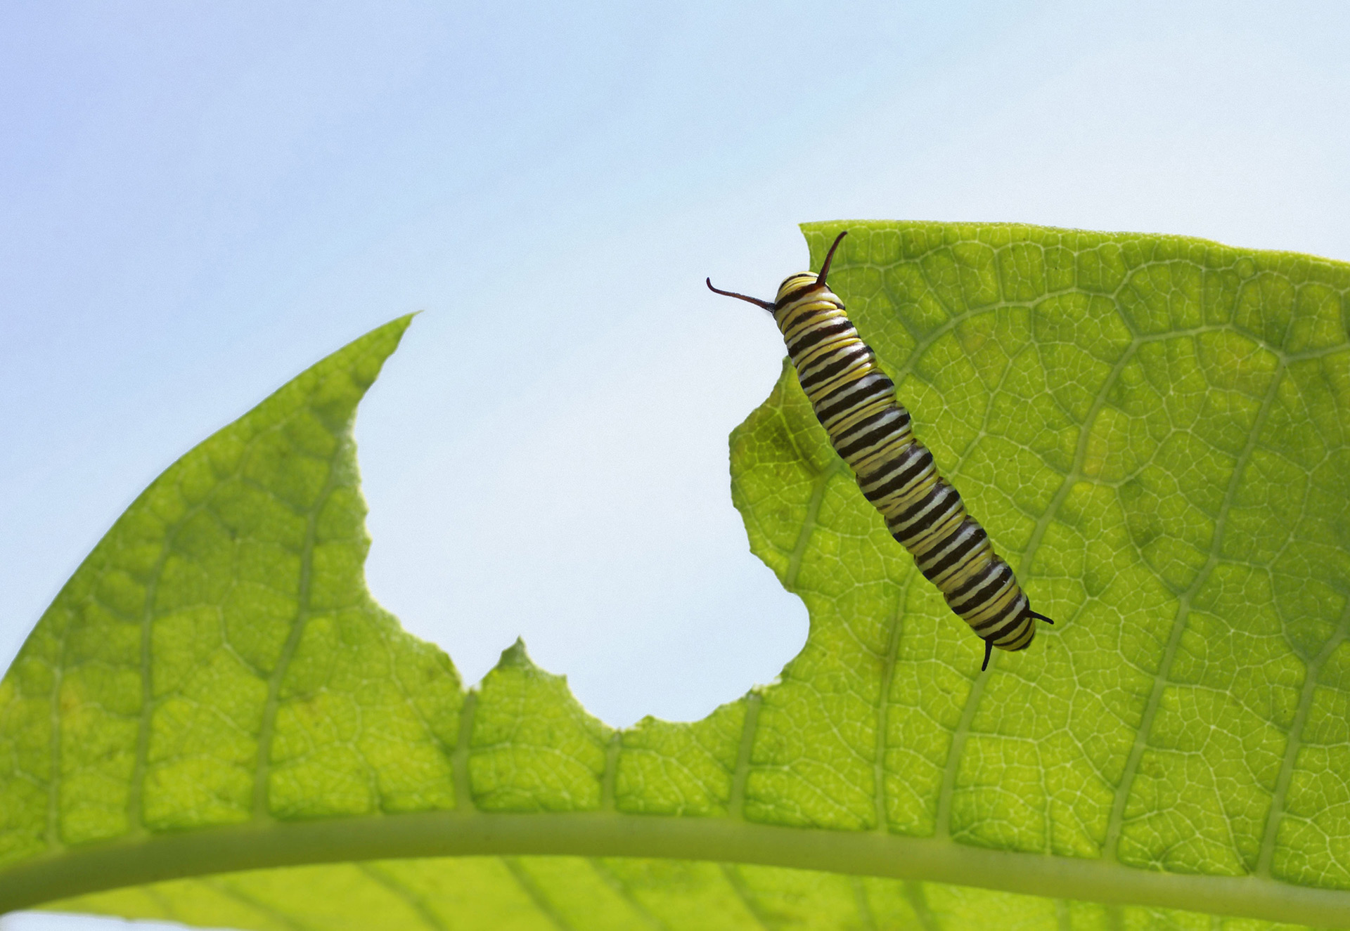
Slide 1: Monday
Hi. I’m Teddy.
Really? I’m Teddy, too!
Once upon a Monday, a turtle met a bear.
One day, two students begin reading a book about a turtle and a bear.
I wonder what else we have in common.
probably not much

Slide 3
Slide 2: Tuesday
What do turtles and bears have in common?
Hmmm…I don’t know. Let’s see!
I have not
one hair on
my body.
Only scales.
Like most mammals,I have hair.
I don’t
think I
like him.
Are you
warm blooded?

Slide 4
Slide 3: Wednesday
I wonder where turtle is going
Let’s get back
to the
story.
Do you
lay eggs?
No,I don't
have teeth,
but I have
a serious bite!
OuCH!
Do you
have
sharp teeth
like me?

Slide 5
Slide 4: Thursday
Why did
you bite
me, Teddy?
Because you
just don't
get it!
Turn the page.
I want to see
what happens
next.
OMG!!! Did that really just happen?
Yes, Teddy bit Teddy!
We have nothing
in common.
We are not
alike and
we never will
be!
I’m a turtle
and you’re
a bear
for goodness
sake.

Slide 6
Slide 5: Friday
Why is
the turtle
so
mean?
Hey man!
Im only
trying to
be nic
I wonder what
the
bear is
going to
do now?
You wouldn't
understand
im a
good listener

Slide 7
Slide 6: Saturday
You
wouldn't
understand.
Im glad he didn't
eat him.
Gross!!!
I’m super
tired and
hungry. Winter is
coming and I’m
not ready for
hibernation.
Wait…you
hibernate?
Me too!

Slide 8
Slide 7: Sunday
Cool! I didn’t
know that
turnles
hibernated
Look’s like we
found something
we have
in common
Hibernation
is
when …
And I can help
you. Like fish?
I love fish.
We are
different
but we
are alike.

